Slide 1
AZ-300T01 M 3: Deploying and Managing Virtual Machines (VMs)
Creating Virtual Machines in the Azure Portal
Creating Virtual Machines (PowerShell)
Creating Virtual Machines using ARM Templates
Deploying Custom Images
Deploying Linux Virtual Machines
Backup and Restore
Monitoring Virtual Machines

Slide 2
Lesson 1: Creating Virtual Machines in the Azure Portal
Creating Virtual Machines (Portal)
Practice: Create a Windows Virtual Machine
Practice: Connect to a Windows Virtual Machine

Slide 3
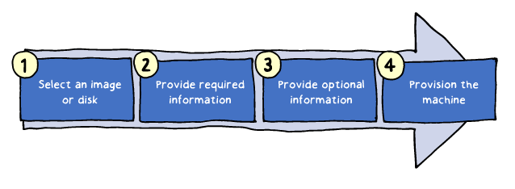
Creating Virtual Machines (Portal)
High level steps:
1. Select a Marketplace image.
2. Provide required information, including:
VM name
Administrative credentials
Virtual network and subnet
Storage type
3. Provide optional information, including:
Availability settings
VM extensions
4. Provision the machine.

Slide 4
Demonstration: Creating Virtual Machines
the ways to create a vm
Notes:
Tell about the ways you can create a vm and tell that we will create together on the upcoming exercise

Slide 5
Demonstration: Detailed Virtual Machine Deployment
Possible to change the settings of the vm after it is created
Notes:
Tell about you can change the sets of the vm after it is created
You will show the possible options on the practice slide

Slide 6
Lesson 2: Creating Virtual Machines (PowerShell)
Virtual Machine Example (Part 1)
Virtual Machine Example (Part 2)
Moving Virtual Machines Between Resource Groups
Demonstration: Create a VM using PowerShell
Practice: Create a Virtual Machine (PowerShell)

Slide 7
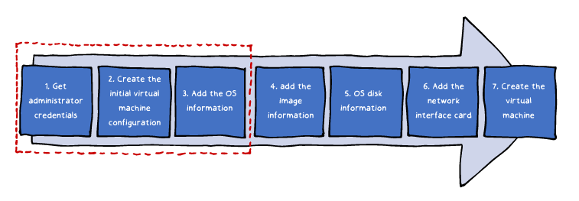
Virtual Machine Example (Part 1)
A sample provisioning (steps 1-3):
1. Set the credentials of the administrator account:
$cred = Get-Credential
2. Create the initial configuration for the virtual machine:
$vm = New-AzureRmVMConfig -VMName myVM -VMSize Standard_D1
3. Add the operating system information to the virtual machine configuration:
$vm = Set-AzureRmVMOperatingSystem `
-VM $vm `
-Windows `
-ComputerName myVM `
-Credential $cred `
-ProvisionVMAgent -EnableAutoUpdate

Slide 8
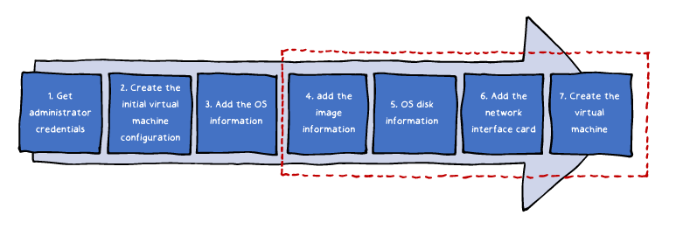
Virtual Machine Example (Part 2)
A sample provisioning (steps 4-7):
4. Add the image information to the virtual machine configuration:
$vm = Set-AzureRmVMSourceImage -VM $vm -PublisherName MicrosoftWindowsServer `
-Offer WindowsServer -Skus 2016-Datacenter -Version latest
5. Add the operating system disk settings to the virtual machine configuration:
$vm = Set-AzureRmVMOSDisk -VM $vm -Name myOsDisk -DiskSizeInGB 128 `
-CreateOption FromImage -Caching ReadWrite
6. Add the network interface card to the virtual machine configuration:
$vm = Add-AzureRmVMNetworkInterface `
-VM $vm -Id $nic.Id
7. Create the virtual machine:
New-AzureRmVM `
-Location EastUS `
-VM $vm `
-ResourceGroupName myResourceGroupVM
Notes:
Provide this powershell
#Create a resource group
New-AzureRmResourceGroup -Name TestM3 -Location EastUs
#Create a subnet configuration
$subnetConfig= New-AzureRmVirtualNetworkSubnetConfig `
-Name M3VNetSN -AddressPrefix 192.168.10.0/25
#Create a virtual network
$vnet= New-AzureRmVirtualNetwork -ResourceGroupName TestM3 -Location EastUS `
-Name M3VNet -Addressprefix 192.168.0.0/16 -Subnet $subnetConfig
#Create a public IP address and specify a DNS name
$pip= New-AzureRmPublicIpAddress -ResourceGroupName TestM3 -Location EastUS `
-AllocationMethod Static -IdleTimeoutInMinutes 4 -Name "M3PublicDNS$(Get-Random)"
#Create an inbound network security group rule for port 3389
$nsgRuleRDP= New-AzureRmNetworkSecurityRuleConfig -Name RDP -Protocol TCP `
-Direction Inbound -Priority 1000 -sourceAddressPrefix * -sourcePortRange * -DestinationAddressPrefix * `
-DestinationPortRange 3389 -Access Allow
#Create an inbound network security group rule for port 80
$nsgRuleWeb= New-AzureRmNetworkSecurityRuleConfig -Name WEB -Protocol TCP -Direction Inbound -Priority 1001 `
-SourceAddressPrefix * -SourcePortRange * -DestinationAddressPrefix * `
-DestinationportRange 80 -Access Allow
#Create a network security group
$nsg= New-AzureRmNetworkSecurityGroup -ResourceGroupName TestM3 -Location EastUS `
-Name M3NSG -SecurityRules $nsgRuleRDP,$nsgRuleWeb
#Create a virtual network card and associate with public IP address and NSG
$nic=New-AzureRmNetworkInterface -Name M3VM01NIC -ResourceGroupName TestM3 -Location EastUS `
-SubnetId $vnet.Subnets[0].Id -PublicIpAddressId $pip.Id -NetworkSecurityGroupId $nsg.Id
#Define a credential object
$secpasswd = ConvertTo-SecureString "1q2w3e4r5t6y*" -AsPlainText -Force
$creds = New-Object System.Management.Automation.PSCredential ("cem", $secpasswd)
#Create a virtual machine configuration
$vmConfig=New-AzureRmVMConfig -VMName M3VM01 -VMSize Standard_DS1_v2 | `
Set-AzureRmVMOperatingSystem -Windows -ComputerName M3VM01 -Credential $creds | `
Set-AzureRmVMSourceImage -PublisherName MicrosoftWindowsServer -Offer WindowsServer `
-Skus 2016-Datacenter -version latest | Add-AzureRmVMNetworkInterface -Id $nic.Id
#Create the VM
New-AzureRmVM -ResourceGroupName TestM3 -Location EastUS -VM $vmConfig

Slide 9
Moving Virtual Machines Between Resource Groups
Supported by using the Azure Portal, PowerShell, CLI, and REST API
Azure PowerShell-based example:
1. Identify ResourceId of all of the dependent resources:
Get-AzureRMResource -ResourceGroupName <sourceResourceGroupName> | Format-table -Property ResourceId
2. Create a comma separated list of the ResourceIds and use the list as input of the Move-AzureRMResource cmdlet:
Move-AzureRmResource -DestinationResourceGroupName "<myDestinationResourceGroup>" `
-ResourceId <myResourceId,myResourceId,myResourceId>
3. For cross-subscriptions moves, include the -DestinationSubscriptionId parameter.
Move-AzureRmResource -DestinationSubscriptionId "<myDestinationSubscriptionID>" `
-DestinationResourceGroupName "<myDestinationResourceGroup>" `
-ResourceId <myResourceId,myResourceId,myResourceId>
Notes:
Whilst moving remind that most of the sets you have will be moved, either via powershell or GUI

Slide 10
Demonstration: Create a VM using PowerShell
We did this on slide 10
Notes:
We did this on slide 10,
If you prefer send the script to delegates to create on their own environment.

Slide 11
Lesson 3: Creating Virtual Machines using ARM Templates
Resource Manager Templates
ARM Process
Demonstration: Create a VM using ARM
Practice: Creating Virtual Machines (Template)

Slide 12
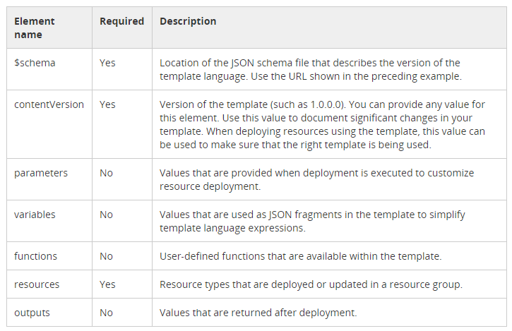
Resource Manager Templates
JSON-formatted documents that follow ARM-specific syntax:
Notes:
Show about the json idea

Slide 13
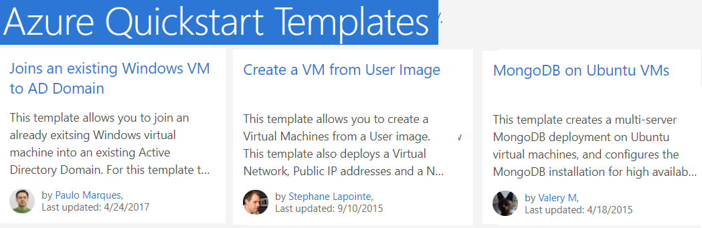
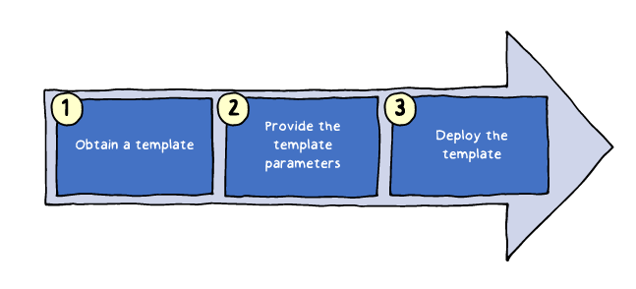
ARM Process
1. Obtain a template:
Consider leveraging QuickStart Templates
2. Provide the template parameters:
Interactively
Via a parameters file.
3. Deploy the template by using:
The Azure portal
Azure PowerShell
Azure CLI

Slide 14
Demonstration: Create a VM using ARM
Use a github example
Notes:
or build your own template if the time permits

Slide 15
Lesson 4: Deploying Custom Images
Video: Creating and Managing Virtual Machine Images
Virtual Machines (Custom Images)
Practice: Create a Custom Image

Slide 16
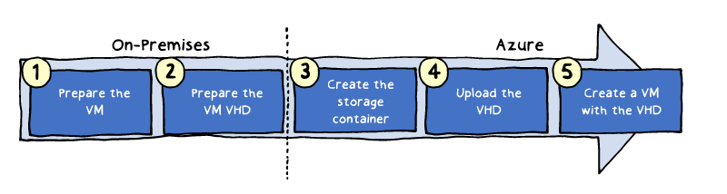
Virtual Machines (Custom Images)
Images are VHD files containing a generalized operating system:
Can be used to provision Azure VMs
Can be created by using on-premises VMs:
On-premises:
Provision a Hyper-V Generation 1 VM using disks in the VHD format
Generalize the VM operating system (for Windows OS, run sysprep)
In Azure:
Create an Azure Storage account and a container
Upload the VM VHD files to the container (e.g. by using the Add-AzureRmVhd cmdlet)

Slide 17
Demonstration: Creating and Managing Virtual Machine Images (Part 1)

Slide 18
Demonstration: Creating and Managing Virtual Machine Images (Part 2)

Slide 19
Lesson 5: Deploying Linux Virtual Machines
Linux Virtual Machines
Demonstration: Deploying Linux Virtual Machines
Connecting to Linux VMs
Video: Creating SSH Keys

Slide 20
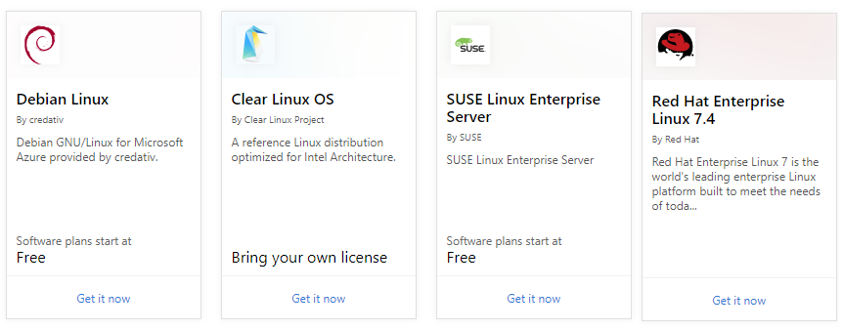
Linux Virtual Machines
Azure supports many Linux distributions including:
CentOS by OpenLogic
Core OS
Debian
Oracle Linux
Red Hat Enterprise Linux
Ubuntu.
Azure Marketplace hosts hundreds of community-built images
Created with Bitnami
Certified for Azure
Linux VMs support the same deployment options as Windows VMs
Linux VMs support open-source DevOps tools, e.g. Puppet and Chef

Slide 21
Demonstration: Deploying Linux Virtual Machines
Notes:
Tell about the ideas of Linux vms on azure

Slide 22
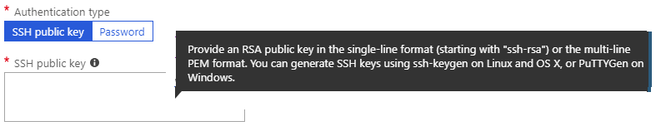
Connecting to Linux VMs
Linux supports two methods of authentication:
Username and SSH-RSA 2048-bit key pair:
Can be generated by using ssh-keygen (Linux) or PuTTYGen (Windows)
Private key should be stored securely on the source computer
Public key resides on the target VM
Username and password

Slide 23
Lesson 6: Backup and Restore
Managing Virtual Machines
Virtual Machine Backups
Backup Virtual Machines
Restore Virtual Machine
Practice: Virtual Machine Backup and Restore

Slide 24
Virtual Machine Backups
Protection of Azure VMs is available by using:
Azure Backup:
Supports application-consistent backups of Windows and Linux VMs
Creates recovery points stored in geo-redundant recovery vaults
Allows for restoring the whole VM or just specific files
Azure Site Recovery:
Protects VMs from outages affecting entire region
Allows recovery with a single click in matter of minutes
Replicates to an Azure region of your choice
Managed Snapshots:
Read-only full copies of managed disks
Exist independently of the source disk
Can be used to create new managed disks for rebuilding a VM
Accrue charges based on the used portion of the disk

Slide 25
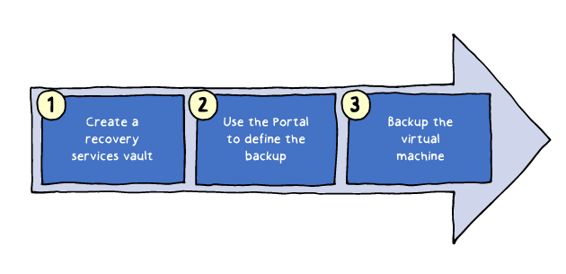
Backup Virtual Machines
Follows a three-step process:
1. Create a Recovery Services vault with either geo-redundant (default) or locally redundant storage.
2. Define the backup policy by specifying frequency of recovery points and their retention period.
3. Initiate backup of Azure VM by installing Backup extension
Backup VM extension has dependency on the Azure VM Agent:
Present by default on Marketplace VM images
Needs to be included in custom VM images

Slide 26
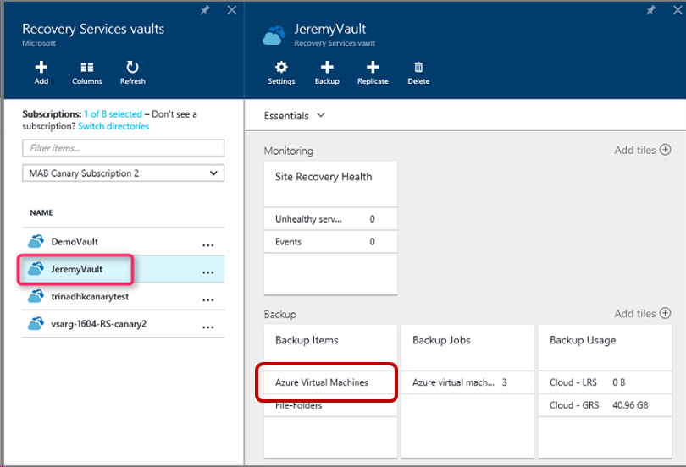
Restore Virtual Machine
You can trigger the restore operation from the Azure portal:
Azure Backup creates a restore job
The portal displays restore progress

Slide 27
Practice: Virtual Machine Backup and Restore
Let me Backup a VM

Slide 28
Lesson 7: Monitoring Virtual Machines
Video: Monitoring Virtual Machines
Monitoring
Diagnostic Settings
Advisor Recommendations
Video: Azure Advisor
Practice: Advisor Recommendations

Slide 29
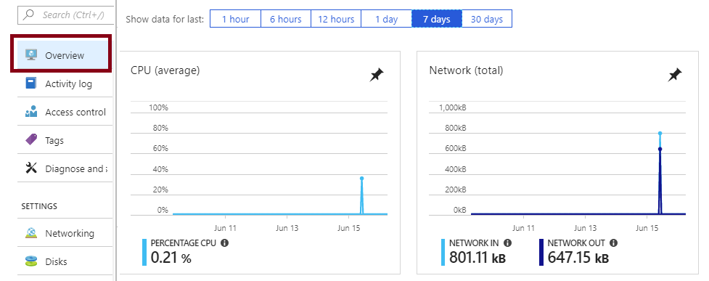
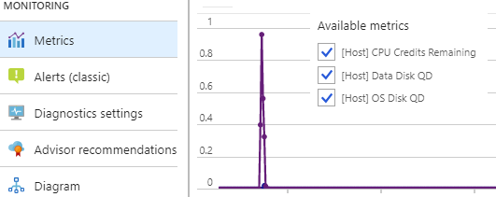
Monitoring
The Azure VM Overview blade in the Azure portal shows:
CPU
Network
Disk bytes
Disk operations
The Azure VM Monitoring section in the Azure portal shows:
Metrics
Diagnostic settings
Advisor recommendations
Diagram.

Slide 30


Diagnostic Settings
On Windows VMs, diagnostics settings include:
Performance counters
Logs
Crash dumps
Agent
Sinks (deliver diagnostics to other services, such as Application Insights)
On Linux VMs, diagnostics settings include:
Metrics
Syslog
Agent

Slide 31
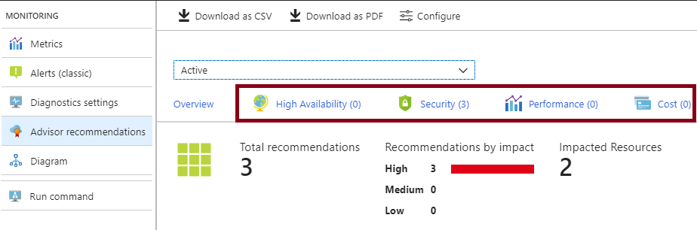
Advisor Recommendations
Personalized cloud service for optimizing Azure deployments:
Analyzes resource configuration and usage telemetry
Offers recommendations grouped in four categories:
High availability: To ensure and improve the continuity of your business-critical applications.
Security: To detect threats and vulnerabilities that might lead to security breaches.
Performance: To improve the speed of your applications.
Cost: To optimize and reduce your overall Azure spending.

Slide 32
Encrypting Virtual Machine Disks
For enhanced virtual machine (VM) security and compliance, virtual disks in Azure can be encrypted and its keys are stored in a Key Vault
Create a cryptographic key in an Azure Key Vault.
Configure the cryptographic key to be usable for encrypting disks.
Enable disk encryption for your virtual disks.
The required cryptographic keys are requested from Azure Key Vault.
The virtual disks are encrypted using the provided cryptographic key

Slide 33
Azure key vault
A cloud service that works as a security-enhanced secrets store:
Allows you to create multiple security-enhanced containers, called vaults
Main vault characteristics:
Support for secrets, such as a password, keys, and certificate.
The use of hardware security modules (HSMs) for key storage and cryptographic operations
The ability to request and renew TLS certificates
Logging of all operations.

Slide 34
Accessing Key Vault in Azure CLI
To create a vault by using the Azure CLI, run:
az keyvault create --name contosovault --resource-group SecurityGroup --location westus
To add a secret to the vault, run:
az keyvault secret set --vault-name contosovault --name DatabasePassword --value 'Pa5w.rd‘
To view the secret value, run:
az keyvault secret show --vault-name contosovault --name DatabasePassword

